Slide 1
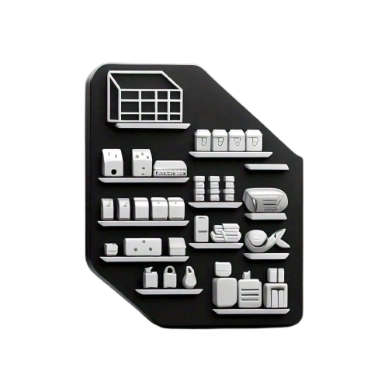
Inventory Management System.

Slide 2
Group Members:
1. Sameer (SP23-BSE-003)
2. Huzaifa Farooq (SP23-BSE-005)
3. Huzaifa Murtaza (SP23-BSE-007)
4. Hamza (SP23-BSE-015)
5. Azlan (SP23-BSE-023)
6. Talha (SP23-BSE-028)

Slide 3
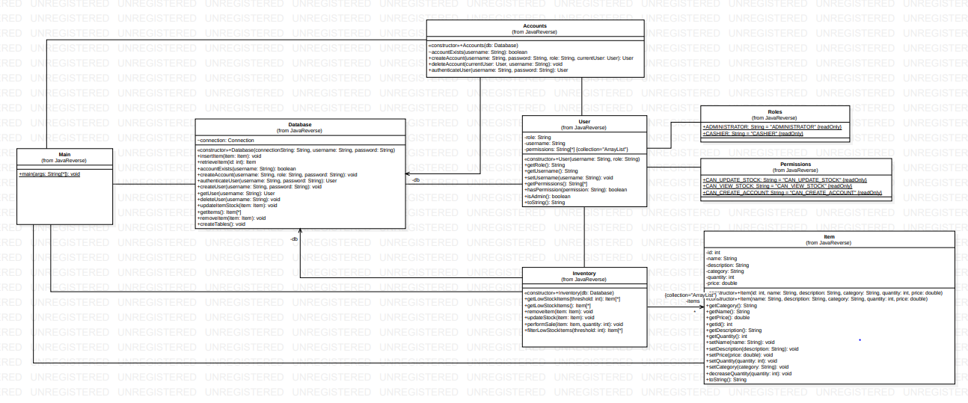
Class Diagram

Slide 4
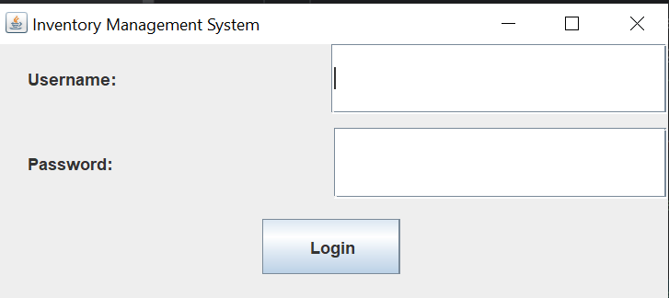
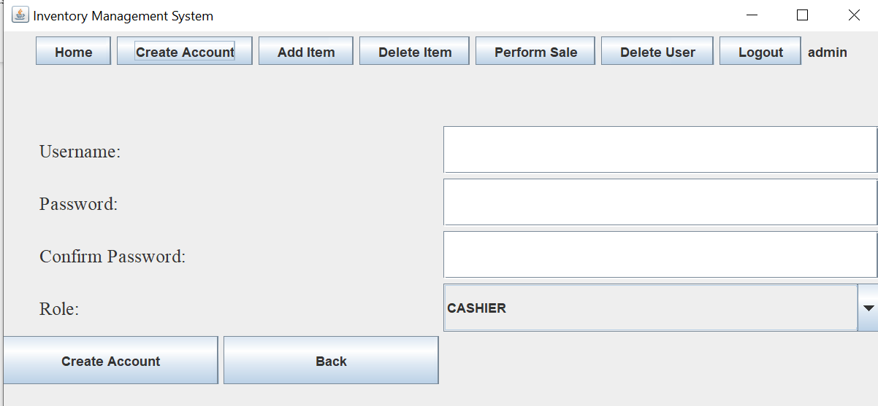
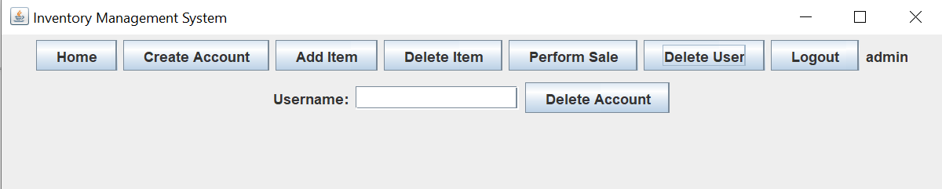
User Management:
Users should be able to log in and log out of the system.
Administrators should be able to create new user accounts with specified roles.
Administrators should be able to delete user accounts.
A user can only delete their own account or other accounts if they are an administrator.

Slide 5
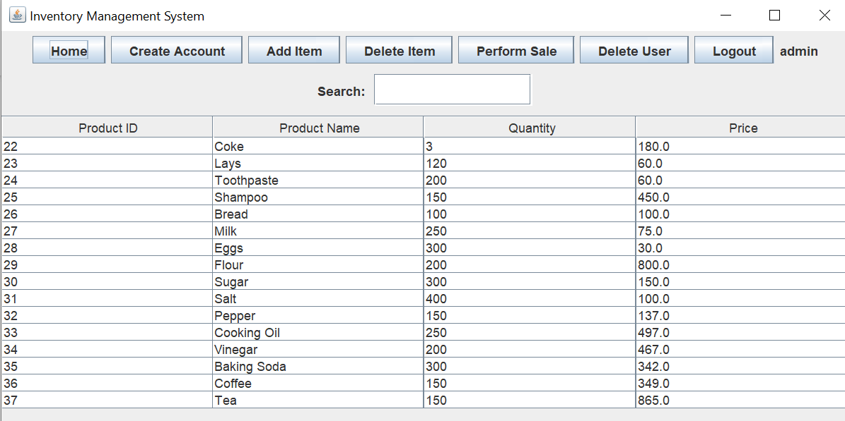
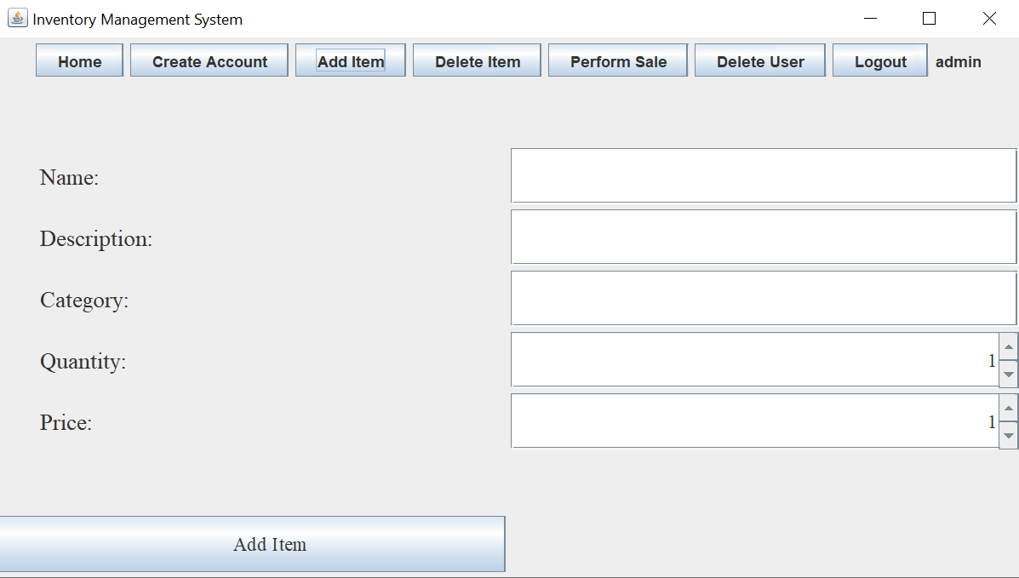
Item Management:
Users with appropriate permissions (e.g., administrators, cashiers) should be able to add new items to the inventory.
Users with appropriate permissions should be able to view a list of all items in the inventory.
Users with appropriate permissions should be able to remove items from the inventory.
The system should track the quantity of each item in stock.

Slide 6
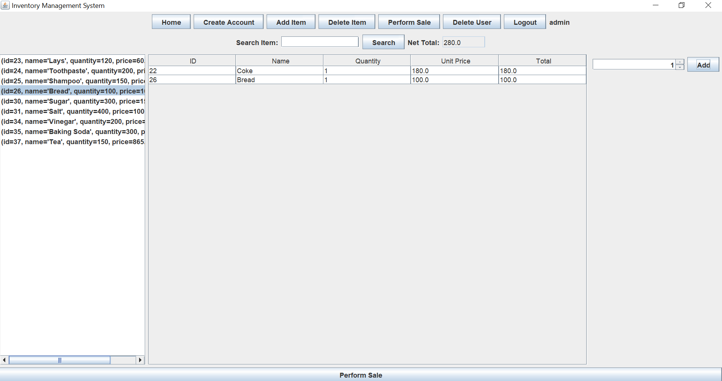
The system should allow users with appropriate permissions (e.g., cashiers) to perform sales of items.
When an item is sold, the system should decrease the quantity of that item in stock.
Sales:

Slide 7

Any Questions?

